Slide 1
Fast R-CNN https://arxiv.org/abs/1504.08083
Mahmud-Un-Nabi (1720307)

Slide 2
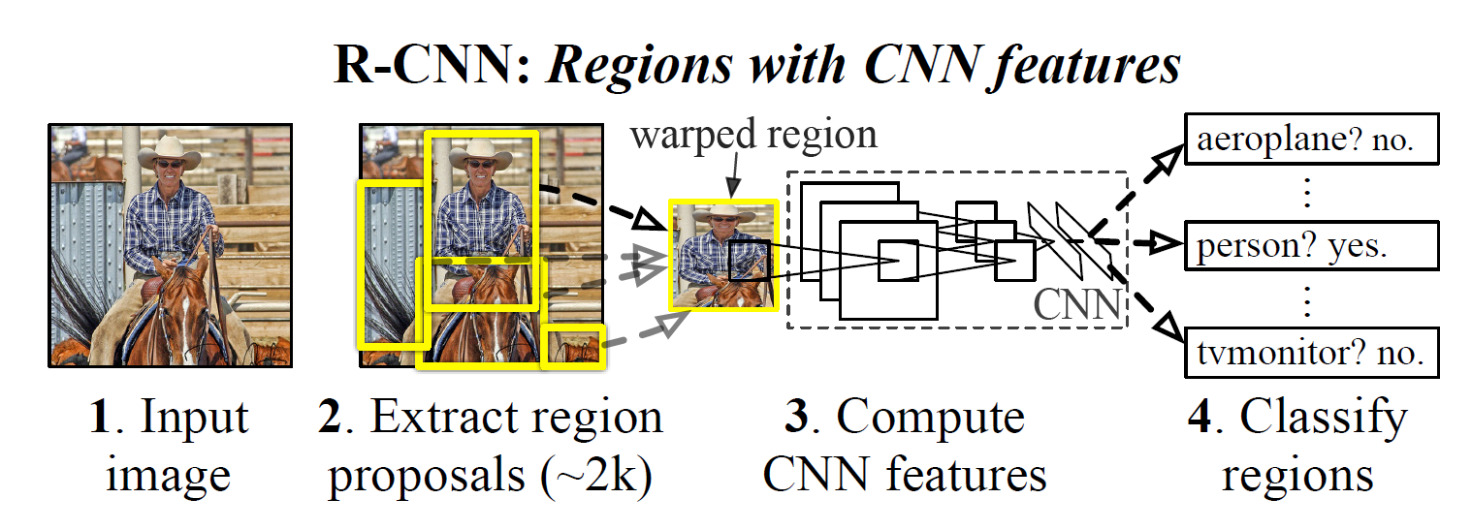
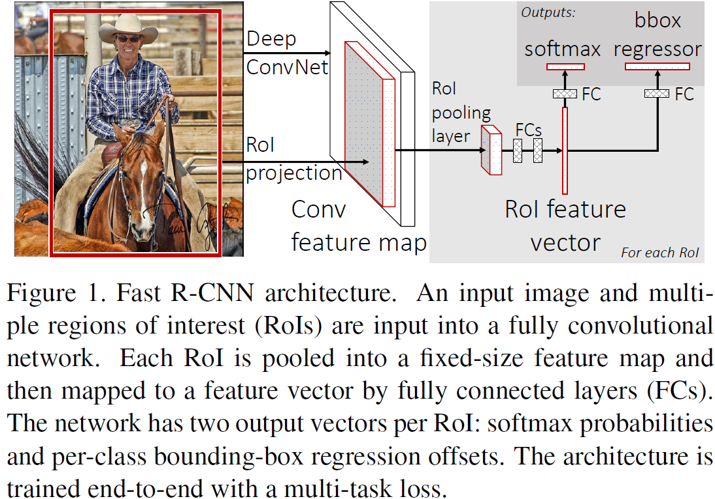
Fast R-CNN
R-CNN

Slide 3
Changes in Fast R-CNN
Instead of using CNN for every 2000 regions proposed by region proposal method, they used CNN for detecting and classifying image in a single forward pass
For classification, they have used softmax instead of SVM .
Instead of warping image before feeding into the network, they used ROI pooling layer on the
extracted feature map.

Slide 4
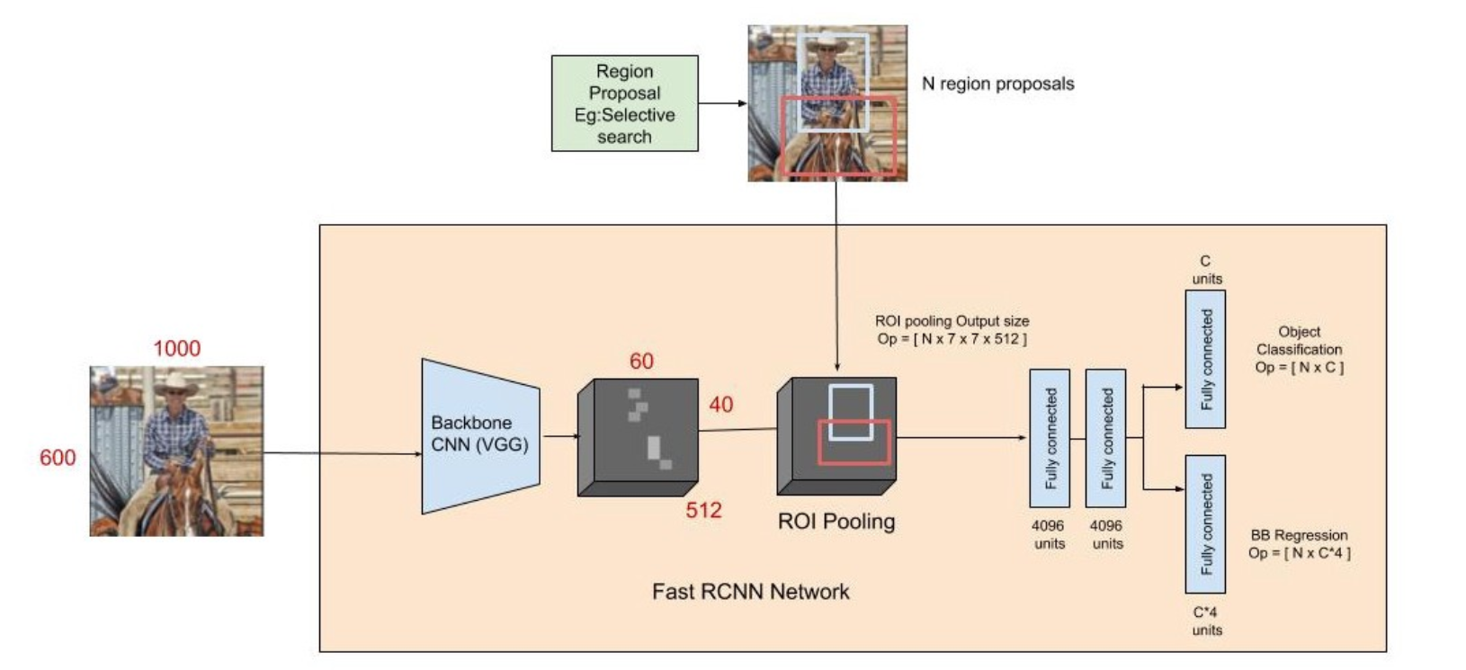
Region of Interest Pooling:
ROI being used on the 60 x 40 x 512 feature maps to convert them to 7 x 7 x 512

Slide 5
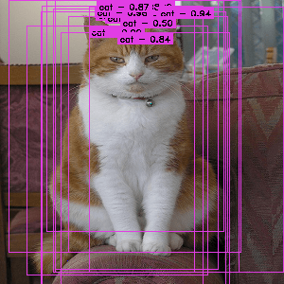
Same Region imposed on
8 x 8 feature map
An image from the Pascal VOC dataset annotated with region proposals (the pink rectangles)
Each ROI is defined by a four-tuple (r,c,h,w) that specifies its top-left corner(r,c) and its height and width(h,w)

Slide 6
Each ROI is defined by a four-tuple (r,c,h,w) that specifies its top-left corner(r,c) and its height and width(h,w)
RoI layer parameters = (pooled height , pooled width , spatial scale)
spatial scale = 1/ (input image size/feature map size)
top-left corner on feature map = (r * spatial scale , c * spatial scale)
Height and width of the region on feature map = (h*spatial scale , w*spatial scale)

Slide 7
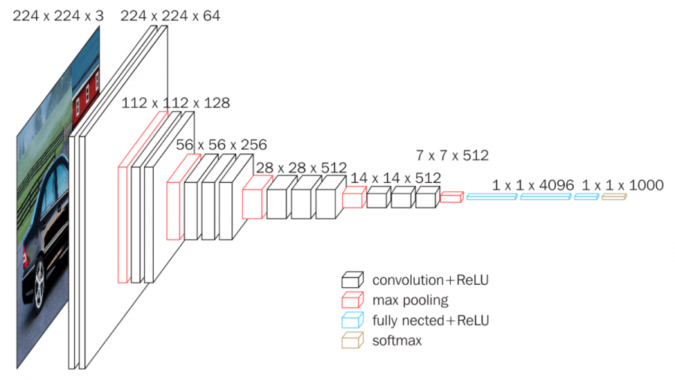
Calculating Spatial scale for VGG-16 net
Size of each input image = 224 x 224 = s_i
Size of feature map before last max-pooling layer = 14 x 14 = s_f
Spatial scale = 1/(s_i/s_f) = 1/16

Slide 8
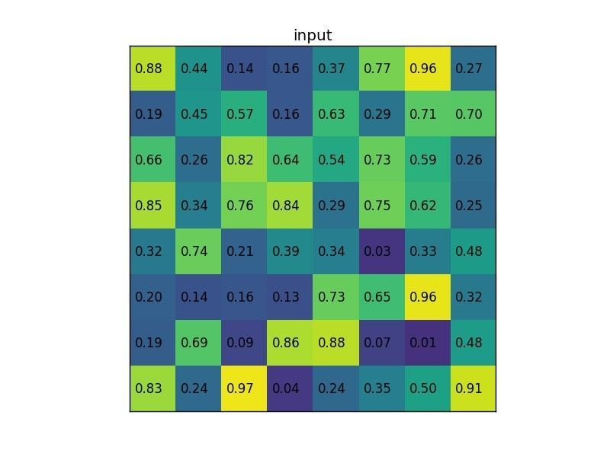

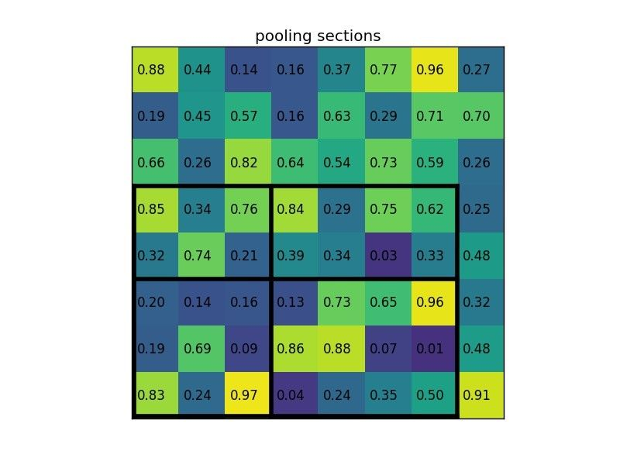
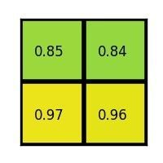
8 x 8 feature map
Region proposed on feature map
for a class ‘X’
Pooling region calculated
Pooled width = 2
Pooled height = 2
Height-wise window = round(region height / pooled height)
Width-wise window = round(region width / pooled width)
Max-Pooled output

Slide 9
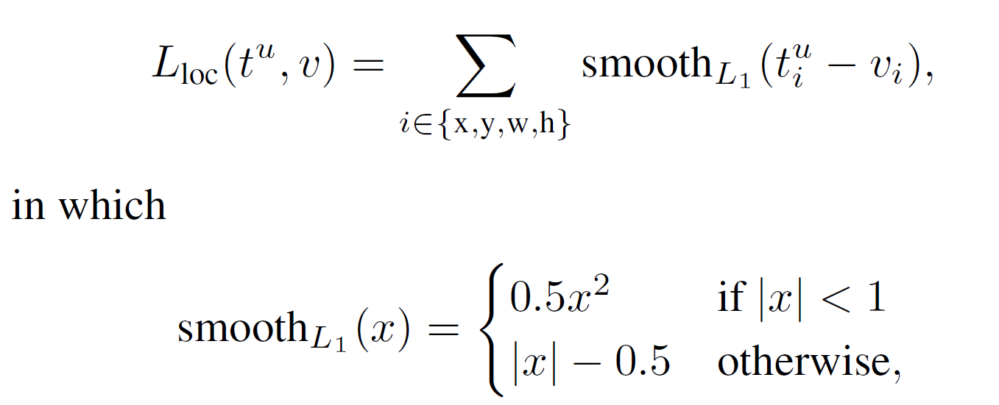
Loss Function:
Smooth l1 loss for regression:
*to prevent exploding gradient

Slide 10
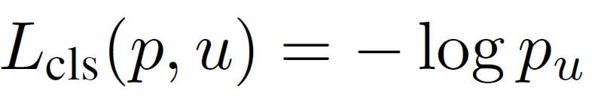
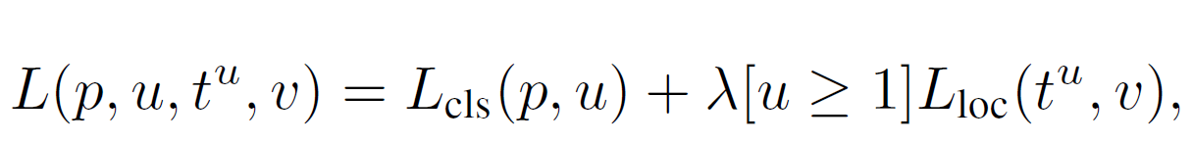
For classification: softmax cross-entropy Loss
Multi-task Loss:
*by convention the value of u = 0 , for background class

